Slide 1
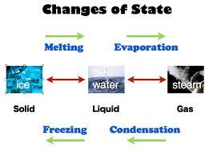
Changes of State
Melting, Freezing, Vaporization, Evaporation, Condensation, Sublimation, Deposition OH MY!

Slide 2
Learning Objectives
I can describe the 6 changes of state (melting, freezing, vaporization, condensation, sublimation, and deposition) in terms of what happens to the energy and spacing of the particles.
I can describe the differences between endothermic and exothermic changes of state.
Notes:
In this lesson, students will learn the definitions of both potential and kinetic energy. They will also be able to give examples of each and explain how potential energy changes into kinetic energy.

Slide 3
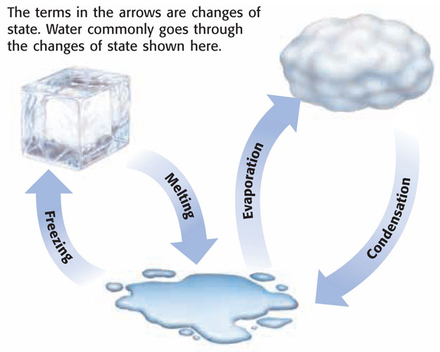

Slide 4
What is a change in state or phase change?
A change of state is changing a substance from one physical form to another.
Phase Change – A reversible physical change that occurs when a substance changes from 1 state to another.
Physical change means the substance only changes it’s appearance; it’s still the same substance!

Slide 5

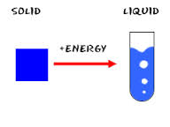
How do substances change state?
A substance can change from one state to another by adding or removing ENERGY!
One type of energy is HEAT…so we are adding heat or removing heat to change states

Slide 6
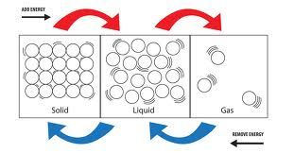
What happens when you add energy…heat?
The more energy/heat (higher temperature) will make the particles move faster.
The more energy/heat will make the particles spread out more and attraction decreases.

Slide 7
Temperature
Temperature – the measure of particles moving (speed) and therefore a measure of it’s energy.
- Higher temperatures = Fast moving particles
- Lower temperatures = Slow moving particles.

Slide 8
Types of Energy Changes
Endothermic – Heat goes INTO an object from its surroundings.
Exothermic – Heat is RELEASED from an object to the surroundings.

Slide 9
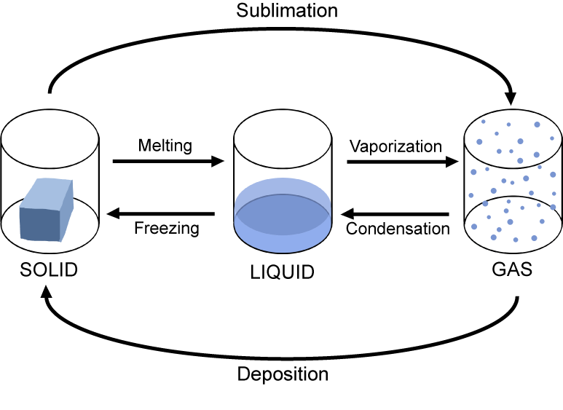
What are the changes in state?
Energy is absorbed - Endothermic
Melting
Vaporization
Sublimation
Freezing
Condensation
Deposition
Energy is released - Exothermic

Slide 10
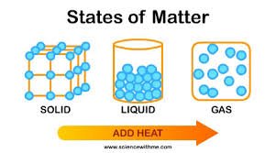
Change of state: MELTING
Melting: The change of a solid to a liquid.
Energy (HEAT) must be added to the substance to make it melt.
Endothermic

Slide 11
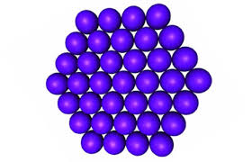
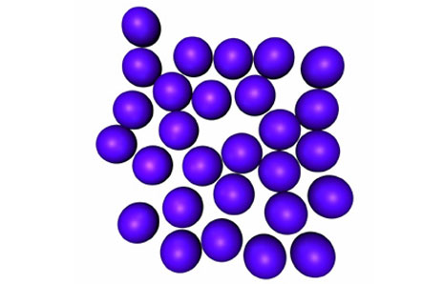
Melting…
As the substance is melting, the particles are moving faster because energy/heat was added.
The particles are also spreading out more because the attraction is less and they are going from a solid (packed together) into a liquid (loosely packed)

Slide 12
Change of state: Vaporization
Vaporization: The change of a liquid to gas.
Energy/heat must be added to make it evaporate
Endothermic

Slide 13
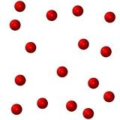
Vaporization….
The particles are moving even faster as they go from a liquid to a gas
The particles are spreading out farther and attraction is decreasing.

Slide 14
Change of state: SUBLIMATION
Sublimation: The change of a solid directly to a gas.
Energy must be added.
  Think: As dry ice is exposed to a warmer temperature (more energy) it will begin to look like its steaming.
Particles are moving faster as the solid turns into a gas
Endothermic
Example: Dry ice

Slide 15
Reverse
REVERSE!

Slide 16
What happens when you remove energy…heat?
If you remove energy/heat (lower temperature) the particles move slower
The less energy/heat will make the particles move together more and attraction increases.

Slide 17
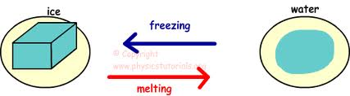
Change of state: FREEZING
Freezing: The change of a liquid to a solid.
Energy/heat must be removed to make the substance freeze.
Exothermic

Slide 18
Freezing….
As energy/heat is removed and the substance is freezing, the particles are starting to move slower.
As energy/heat is removed to freeze, the particles are getting closer and attraction is increasing.

Slide 19
Change of state: CONDENSATION
Condensation: The change of a gas to a liquid.
Energy/heat must be removed to change a gas to a liquid.
Exothermic
Example: All the steam from a hot shower creates condensation (water droplets) on the mirror.

Slide 20
Condensation…
As energy/heat is removed in condensation, particles are moving slower.
As energy/heat is removed in condensation, the particles get closer and the attraction increases.

Slide 21
Change of state: Deposition
Deposition: The change of a gas directly to a solid.
Energy must be removed (taken away).
Particles are moving slower as the gas turns into a solid
Exothermic
Example: Frost on windows

Slide 22
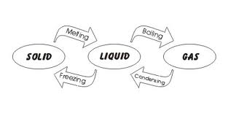
Wrap up!

Slide 23
Energy is absorbed - Endothermic
Energy is released - Exothermic

Slide 24
Phase Changes
Phase Change | Phase to Phase Ex. Solid to Gas | Endothermic or Exothermic?
Melting | Solid to Liquid | Endothermic
Freezing | Liquid to Solid | Exothermic
Vaporization | Liquid to Gas | Endothermic
Condensation | Gas to Liquid | Exothermic
Sublimation | Solid to Gas | Endothermic
Deposition | Gas to Solid | Exothermic

Slide 25
Points Where Phase Changes Occur
Melting Point – Temperature at which a solid turns to a liquid.
Freezing Point -Temperature at which a liquid turns to a solid.
Boiling Point -Temperature at which a liquid turns to a gas.
Condensation Point - Temperature at which a gas turns to a liquid.

