Slide 1
Periodic Trends

Slide 2
Periodic Law
When elements are arranged in order of increasing atomic #, elements with similar properties appear at regular intervals.

Slide 3
Trends
Atomic Radius
Ionization Energy
Electronegativity
Valence Electrons
Energy Levels
Reactivity of Metals
Reactivity of Nonmetals
Melting and Boiling Points

Slide 4
Atomic Radius
Atomic Radius – Size of an atom
K
Na
Li
Ar
Ne

Slide 5
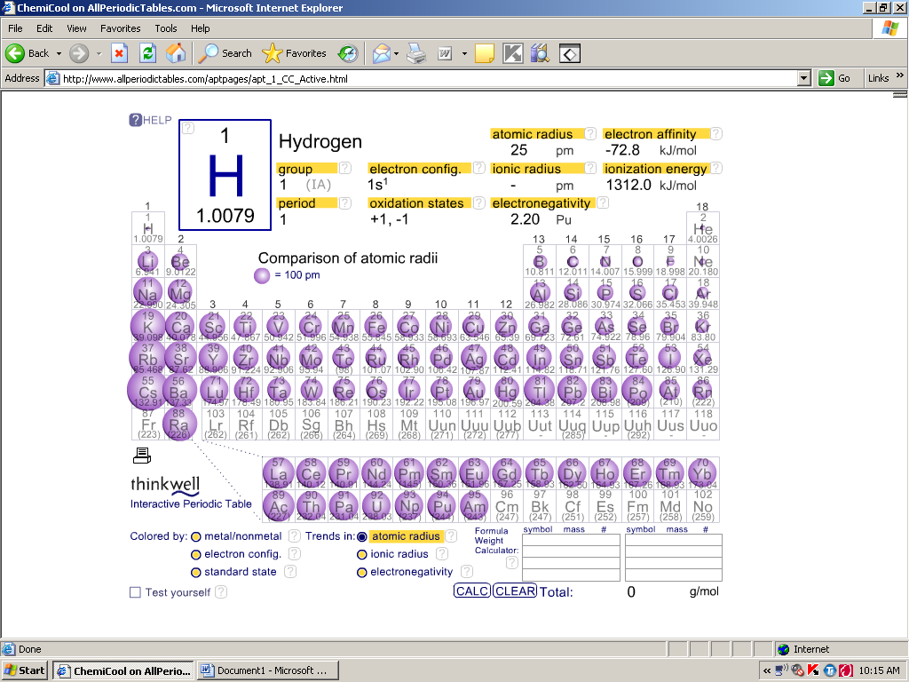
Atomic Radius: Decreases
Atomic Radius: Increases
Periodic Trend: Atomic Radius

Slide 6
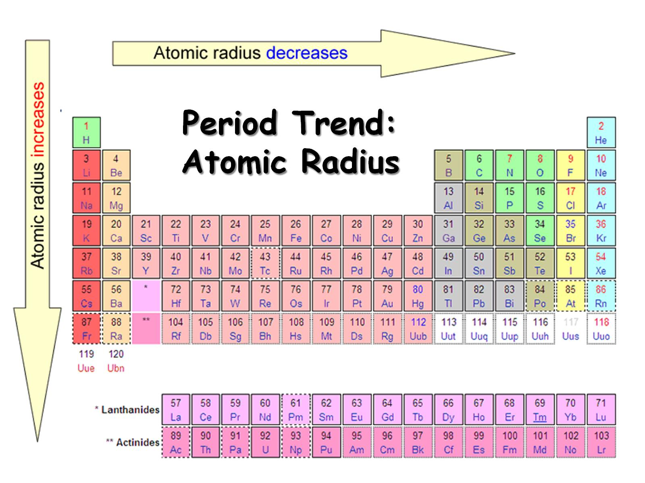
Period Trend:
Atomic Radius

Slide 7
Atomic Radius
Smaller (Decreases) to the right
  Increased nuclear charge without additional shielding pulls e⁻ in tighter
Larger (increases) going down
  Jump in size of nucleus and new energy level
  Shielding - core e⁻ block the attraction between the nucleus and the valence e⁻

Slide 8
Ionization Energy
Ionization Energy – Energy required to remove the outermost electrons
He
Ne
Ar
Li
Na
K

Slide 9
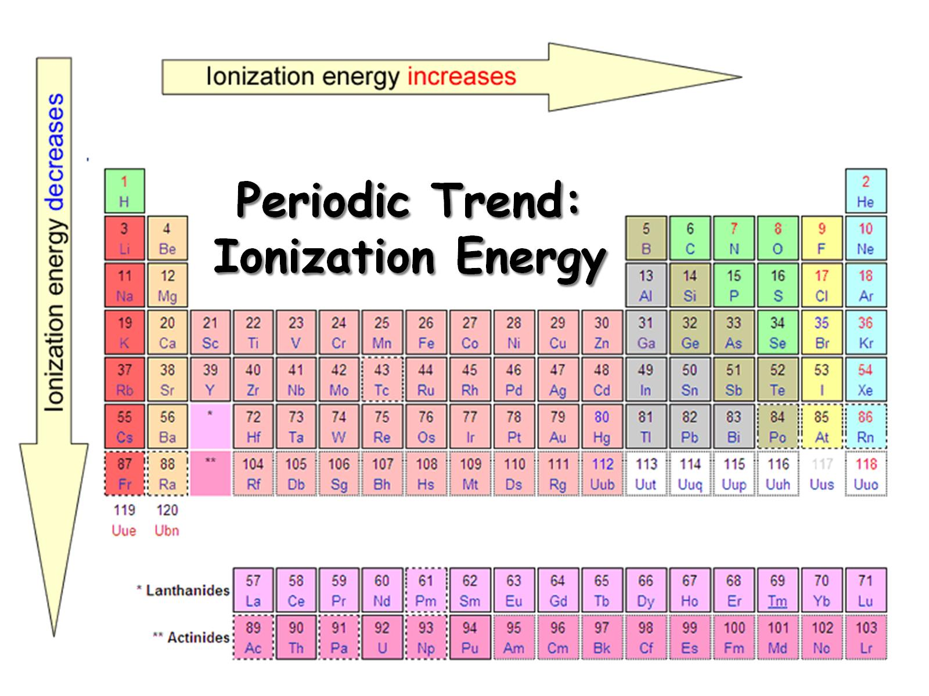
Periodic Trend:
Ionization Energy

Slide 10
Ionization Energy
Increases to the right
  In small atoms, e⁻ are close to the nucleus where the attraction is stronger and nuclear charge increases so attraction between nucleus and electrons increases.
Decreases going down
  More energy levels have electrons further from the nucleus so attraction less and the shielding affect.

Slide 11
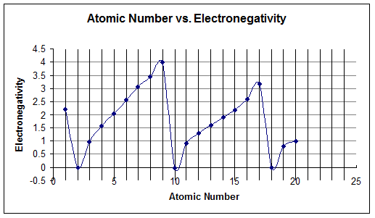
Electronegativity
Electronegativity – An atom’s desire to grab another atom’s electrons.
F
Cl
Li
Na
K
He
Ne
Ar

Slide 12
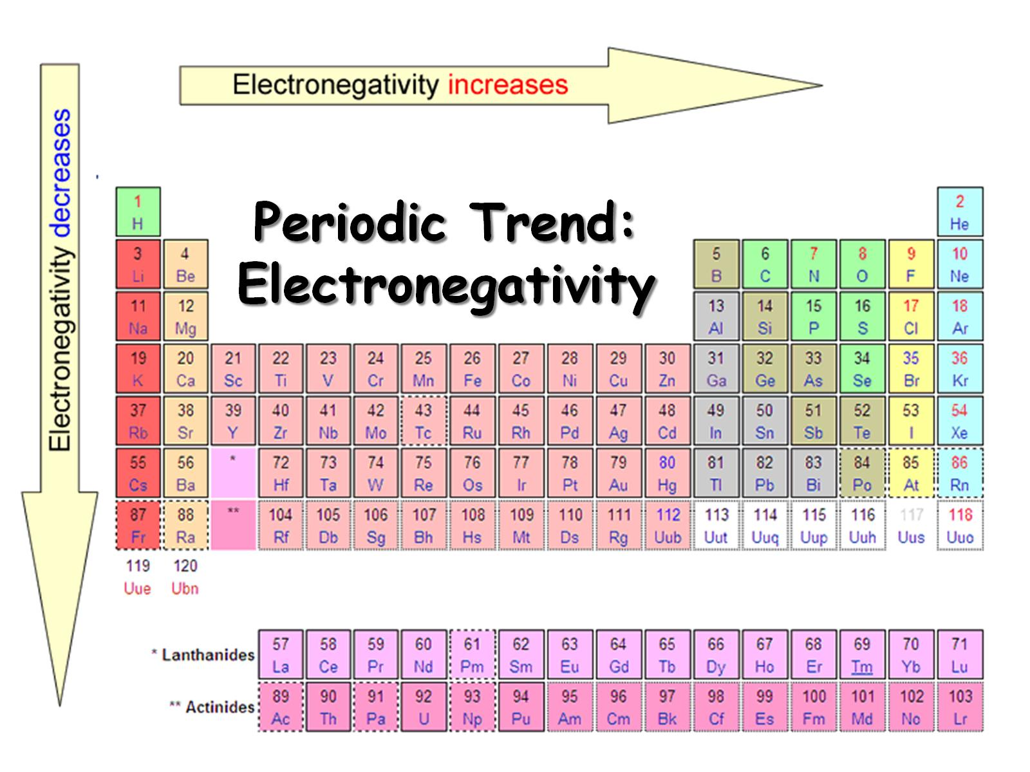
Periodic Trend:
Electronegativity

Slide 13
Electronegativity
Increases to the Right
  Electrons are closer to the nucleus and nuclear charge is greater so attraction between nucleus and valence electrons greater.
Decreases going down
  Shielding affect where electrons in lower energy levels shield the positive charge of the nucleus to the electrons so attraction is less between nucleus and valence electrons

Slide 14
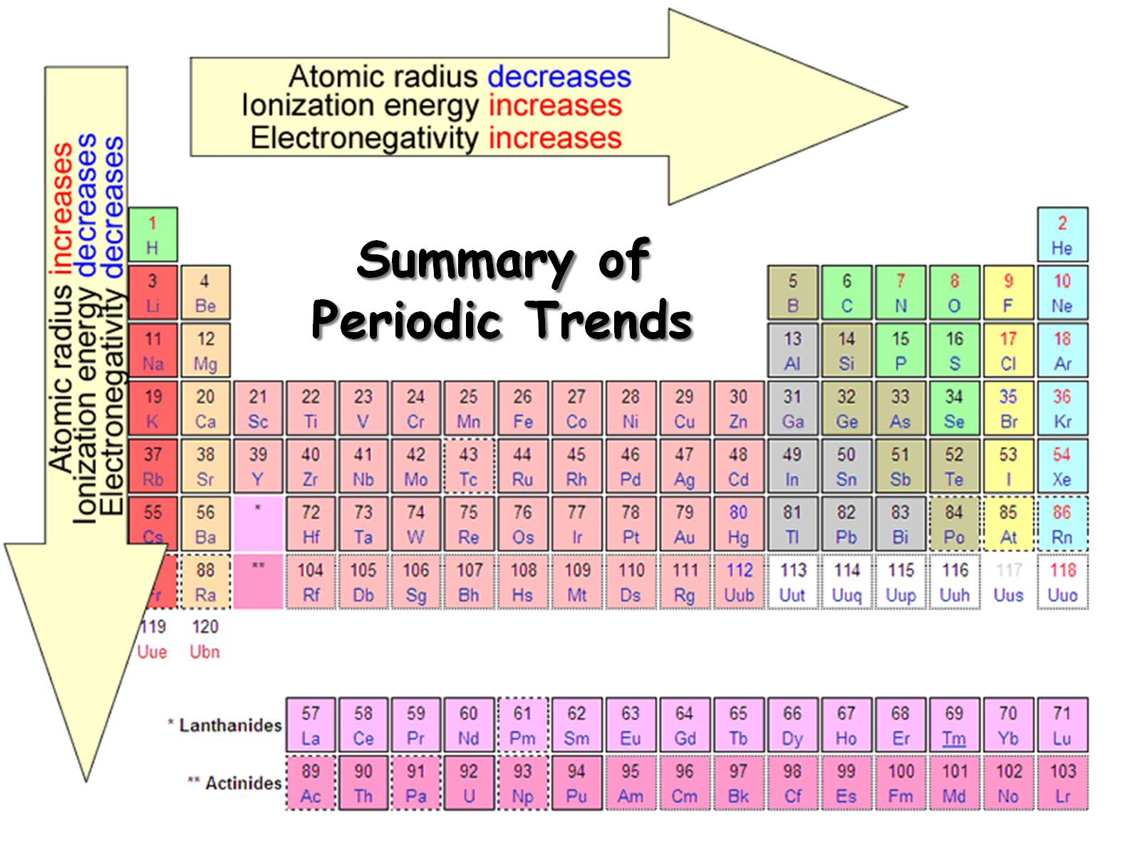
Summary of
Periodic Trends

Slide 15
Chemical Reactivity
Families
  Similar valence e⁻ within a group result in similar chemical properties

Slide 16
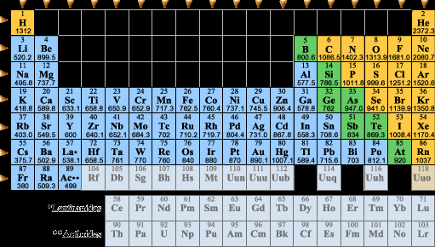
Reactivity of Metals
Reactivity of Metals: Decreases
Reactivity of Metals: Increases
Francium is the most reactive metal
Francium most reactive Metal

Slide 17
Reactivity of Metals
Decreases to the right
  Nuclear charge increases and electrons are closer so stronger attraction for electrons and higher ionization energy.
Increases going down
  More energy levels so electrons are farther away and shielding electrons cause attraction to be less between nucleus and electrons.

Slide 18
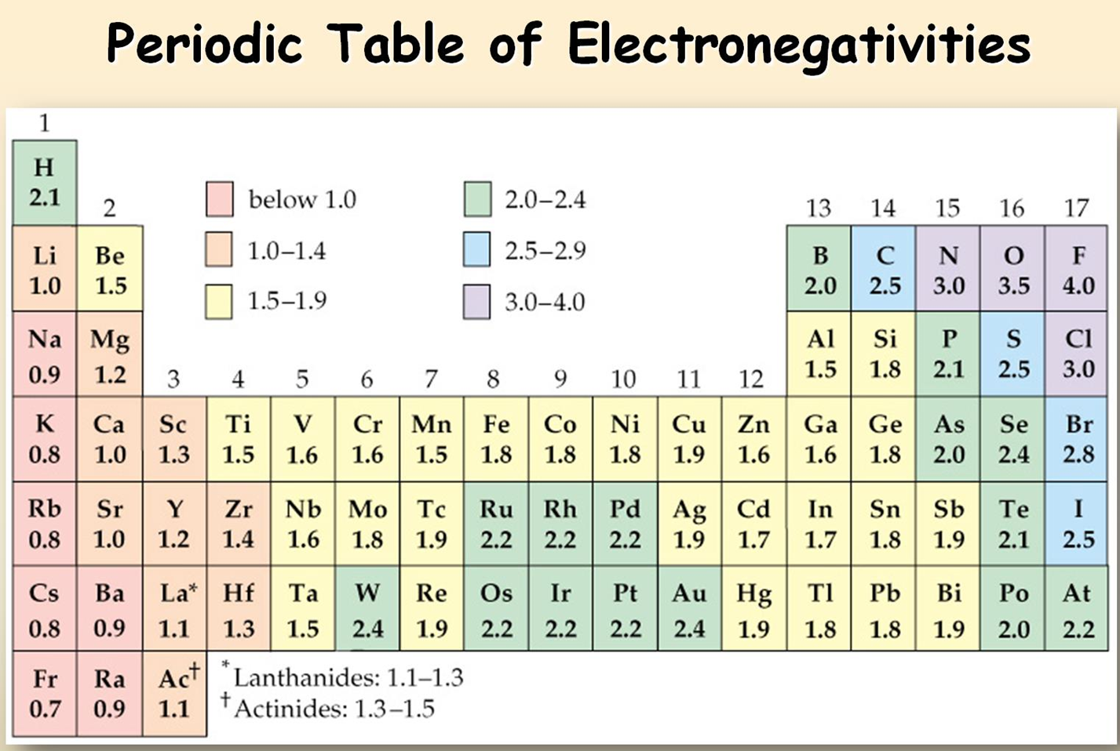
Reactivity of Nonmetals
Reactivity of Nonmetals: Increases
Fluorine is most reactive Nonmetal
Reactivity of Nonmetals: Decreases
Fluorine is the most reactive Nonmetal

Slide 19
Reactivity of Nonmetals
Increases to the right
  Nuclear charge increases so stronger attraction for electrons and higher electronegativity.
Decreases going down
  Nuclear charge decreases due to shielding electrons and the electrons are further away. This causes lower electronegativities.

Slide 20
Melting/Boiling Point
Melting/Boiling Point
  Highest in the middle of a period.

Slide 21
